Slide 1
Econ 210a: Commercial Revolutions (February 5, 2020a)
J. Bradford DeLong
Spring 2019
Evans 648
W 1:10-3:00 pm
<https://bcourses.berkeley.edu/courses/1487686/>
<https://github.com/braddelong/public-files/blob/master/econ-210a-lecture-3a.pptx>

Slide 2
Commercial Revolutions: Readings for February 5…
Jeremiah E. Dittmar (2011): Information Technology and Economic Change: The Impact of the Printing Press <http://qje.oxfordjournals.org/content/126/3/1133.abstract >
J. Bradford DeLong and Andrei Shleifer (1993): Princes and Merchants: European City Growth before the Industrial Revolution <http://www.jstor.org/stable/725804 >
Daron Acemoglu, Simon Johnson, and James Robinson (2005): The Rise of Europe: Atlantic Trade, Institutional Change, and Economic Growth <http://www.jstor.org/stable/4132729>

Slide 3
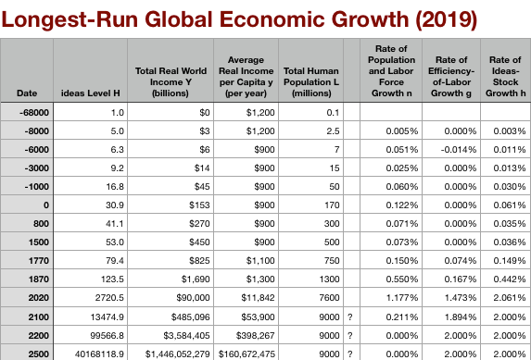
Global Numbers
The Commercial Revolution acceleration appears everywhere
Due to globalization
And especially to the “Columbian Exchange”
“West” has an edge in global transport post-1500 (not pre!)
But “West” on the defensive in Balkans until 1683
Mohacs 1526, Malta 1565, Cyprus 1572, Crete 1669, sieges of Vienna 1529, 1683)

Slide 4

“Western” Numbers
Is ‘the west’ special between 800 and 1500?
Or is it just recovery from a Dark Age depression?

Slide 5
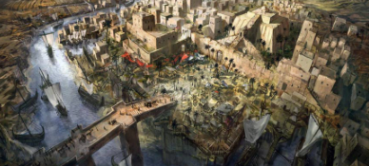
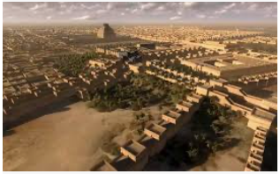
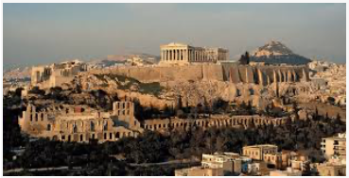
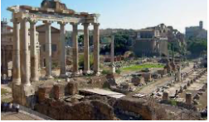
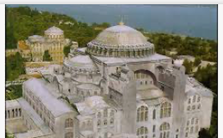
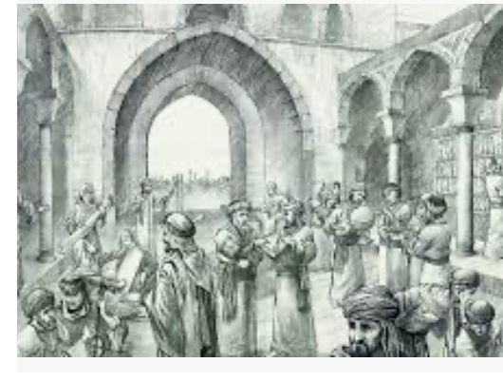
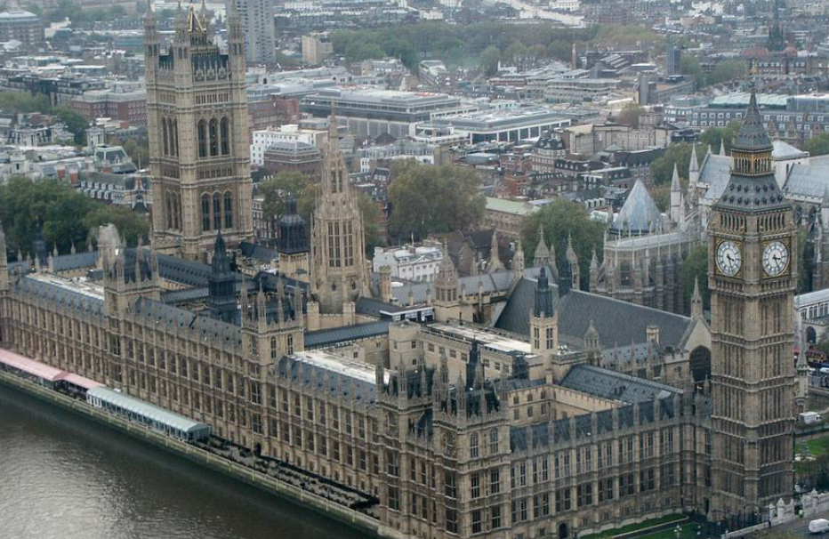

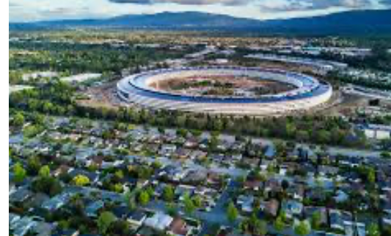
“West”?

Slide 6
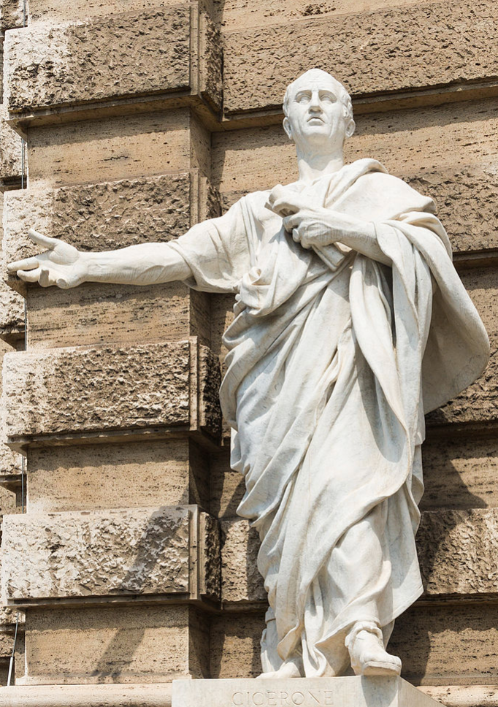
Cicero on Britain
Cicero to Atticus: Epistulae ad Atticum 4.17:
“Now for the rest. A letter from my brother contains some quite extraordinary things about Caesar's warm feelings towards me, and is corroborated by a very copious letter from Caesar himself. The result of the war against Britain is eagerly awaited, for the approaches to the island are known to be 'warded with wondrous massy walls.' It is also now ascertained that there isn't a grain of silver on the island nor any prospect of booty apart from captives, and I fancy you won't expect any of them to be highly qualified in literature or music!…”
“Cognosce cetera. Ex fratris litteris incredibilia de Caesaris in me amore cognovi, eaque sunt ipsius Caesaris uberrimis litteris confirmata. Britannici belli exitus exspectatur; constat enim aditus insulae esse muratos mirificis molibus. etiam illud iam cognitum est neque argenti scripulum esse ullum in illa insula neque ullam spem praedae nisi ex mancipiis; ex quibus nullos puto te litteris aut musicis eruditos exspectare…”

Slide 7
Reading Dittmar: Could One Innovation Make Such a Difference?
Jeremiah E. Dittmar (2011): Information Technology and Economic Change: The Impact of the Printing Press <http://qje.oxfordjournals.org/content/126/3/1133.abstract>:
Information economics visits the 1500s…
Inmigration drives city growth
New growth, or redistribution?
What are the economic benefits of printing books, anyway?
Treviso Arithmetic (1478): “I have often been asked by certain youths.… who look forward to mercantile pursuits, to put into writing the fundamental principles of arithmetic…. Here beginneth a Practica, very helpful to all who have to do with that commercial art…”
Gaspar Nicolas (1519): “I am printing this arithmetic because it is a thing so necessary in Portugal for transactions with the merchants of India, Persia, Ethiopia, and other places…”
Even printed books are not easy to transport: “heavy and fragile… sensitive to damp…. Outside printing cities, information on the range of available print media was incomplete and many books were not offered for sale…”
Agglomeration economies and externalities
How much of a difference can a small sector—1% of GDP—actually make?

Slide 8
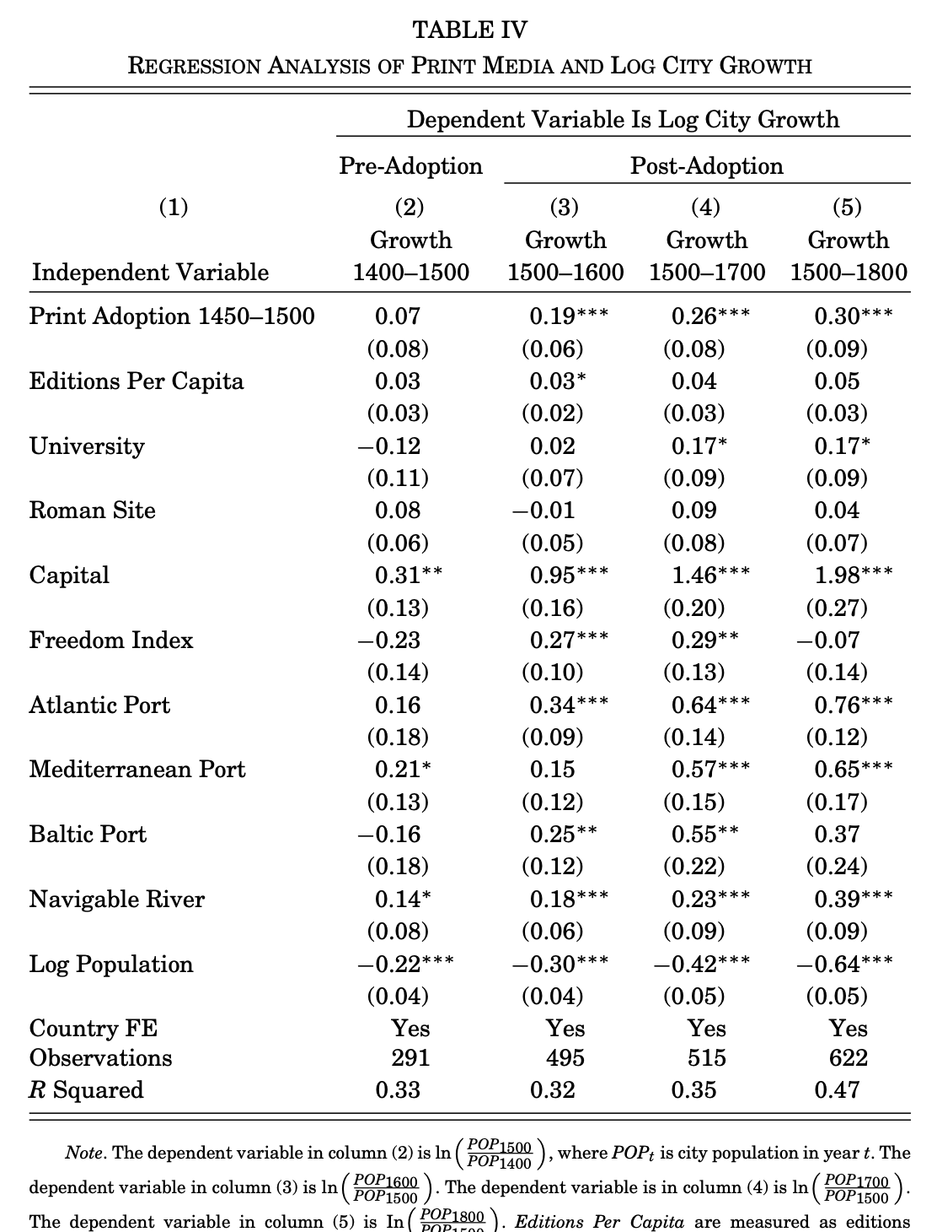
Jeremiah Dittmar (2011): The Printing Press as an Agent of Change…
The “throw everything else into the right-hand side” estimation strategy
Is this an appropriate one?
Confounders, mediators, colliders
The confounder is presumably that potential printers know that there is something about the city that is about to make it grow unexpectedly fast…
Or something about the city that produces a larger-than-expected market for books now and also makes it about to growth unexpectedly fast…
How realistic is it to worry about these?
What would failing to control for these confounders due to the estimated coefficient?

Slide 9
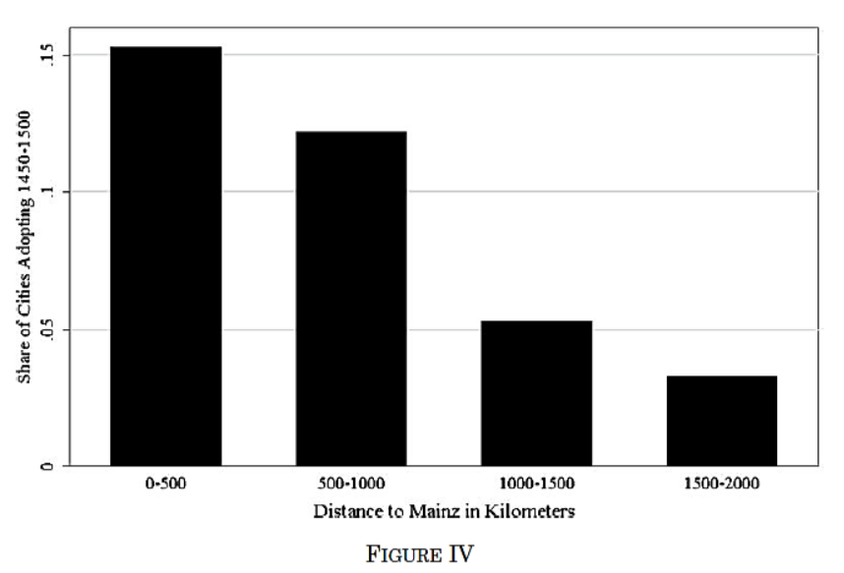
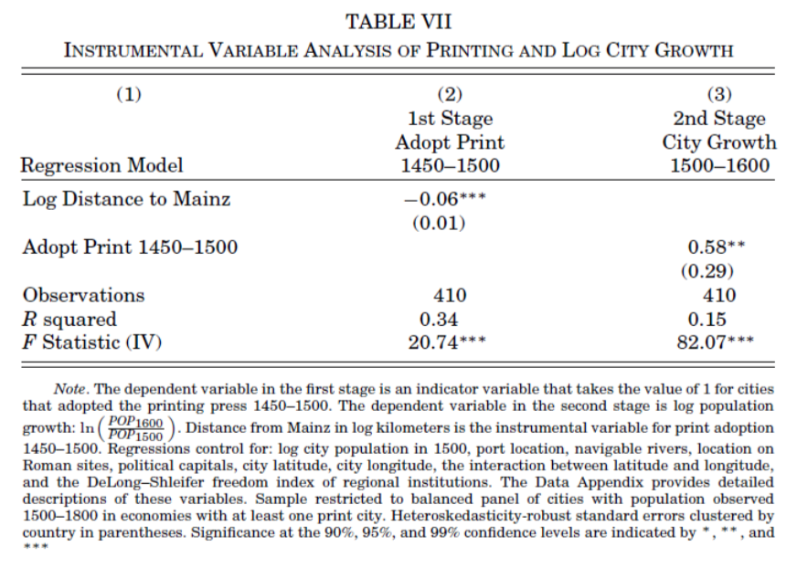
What Should We Think When IV Estimates Are so Much Bigger than OLS Ones?
Distance from Mainz was a significant determinant of technology adoption.
There was no statistically significant relationship between distance from Mainz and city growth before the diffusion of the printing press
There is a very strong one after
Why are DIttmar’s IV estimates so big? 0.6 per century—a near doubling—as opposed to 0.2?

Slide 10

Questions for Dittmar
What is the mechanism here? What do people who read printed books do, exactly, that generates so much in the way of population growth?
What does this tell us about the market system as optimal societal structure?
What else might have been going on that is correlated with "distance from Mainz”?
How should we think about the possibility of finding a “good instrument”, anyway?
Jim Heckman likes to say that you need a structural model before you can figure out if you have a good instrument—and then you might as well do structural estimation. Is he right? Is he wrong?
Once again: why the divergence—and in this particular direction—between OLS and IV estimates?

Slide 11
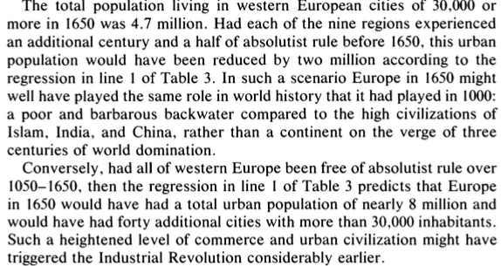
Reading DeLong and Shleifer: Are Cities a Net Plus, or Simply a Redistribution of Activity?
J. Bradford DeLong and Andrei Shleifer (1993): Princes and Merchants: European City Growth before the Industrial Revolution <http://www.jstor.org/stable/725804>
It’s a big deal:

Slide 12
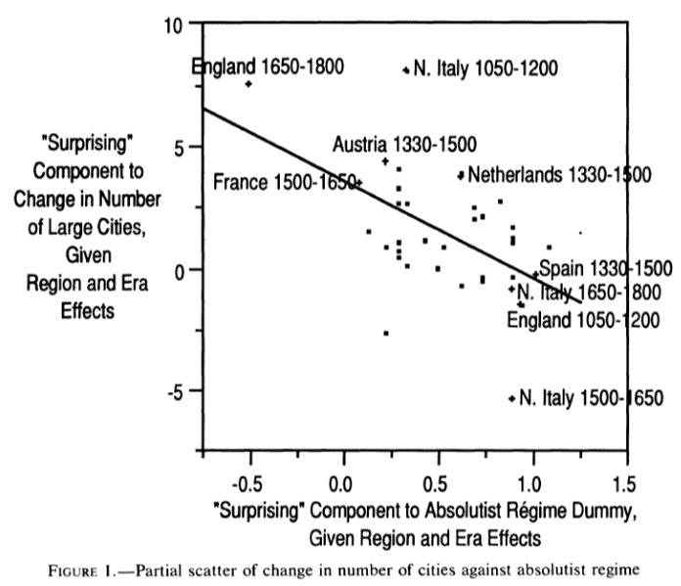
DeLong and Shleifer III
Northern Italy in 1500-1650 is “surprising” as absolutist then
England 1650-1800 is “surprising” as non-absolutist then
WTF?! with the Italian urban boom 1050-1200
Econometric problems
Normal distribution—we have only 45 observations, and 30 degrees of freedom…
The file-drawer problem…

Slide 13


Questions for DeLong and Shleifer
In which genre is this paper: the “freedom of the citizen” genre or the “character of the elites” genre?
Why should absolutist versus limited government be such a big deal?
And why “limited”—the British government was very good at stealing stuff that did not belong to the gentry/merchant aristocracy; in fact, that’s what Marx is all about?
What is assumed direction of effect and mechanism?
Urbanization as indicator: Is this sensible?
New growth, or stealing urban population from elsewhere?

Slide 14
Charles Wilson (1966)
“The two areas... in 1500... richest and most advanced... the quadrilateral... Milan, Venice, Florence, and Genoa; and the strip... from Ypres... to Antwerp.
“It was not merely coincidence that these were the areas where the tradesmen of the cities had been most successful in emancipating themselves from feudal interference, and in keeping at bay the newer threat of more centralized political control offered by the new monarchies. In the fleeting intervals between the storms of politics and war, men here glimpsed the material advance that was possible when tradesmen were left in peace unflattered by the attentions of strategists who regarded their activities as the sinews of war....
“The precocious economic development of the cities of Italy and the Low Countries was cradled in the civic independence of those cities where merchants had achieved political power...

Slide 15
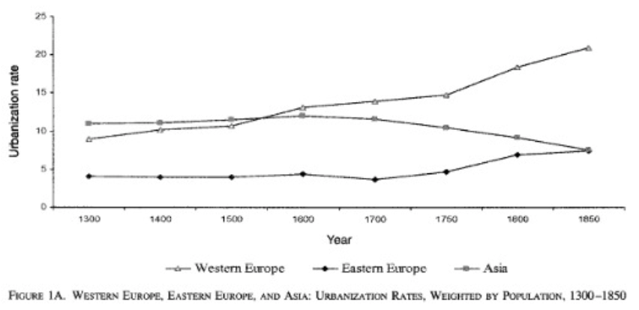
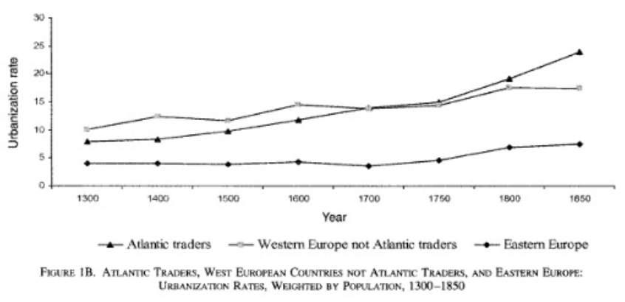
Reading Acemoglu: Wait a Minute! It Was Spain—and Portugal!
Daron Acemoglu, Simon Johnson, and James Robinson (2005): The Rise of Europe: Atlantic Trade, Institutional Change, and Economic Growth <http://www.jstor.org/stable/4132729>
Atlantic Western Europe is England, France, the Netherlands, Portugal, and Spain

Slide 16
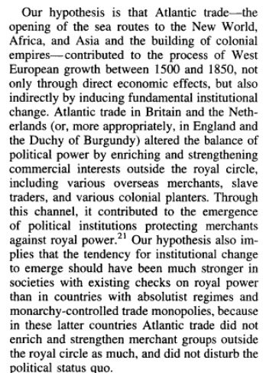
AJR

Slide 17
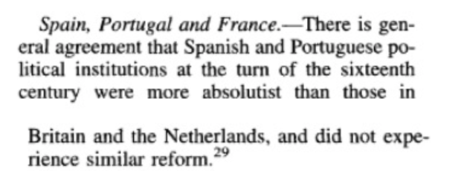
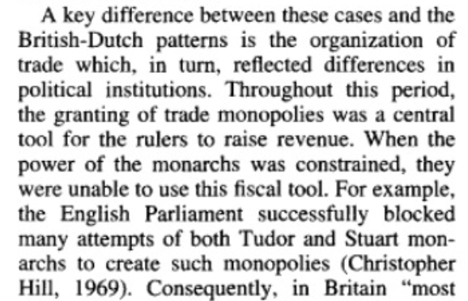
AJR

Slide 18
Questions About AJR
We are talking an extra 10% of the population in cities here. Is this reasonable to attribute to the effects of good government?
Is 10% of the population more in cities enough to have big effects?
What is it about “Atlantic trade" that tends to produce good government?
Where does “limited government” come from that makes “Atlantic trade” a good instrument?
What are the direct effects of “Atlantic trade”?
What do AJR claim are the indirect effects?
Why do they think the indirect effects are materially large?
What would convince them they were wrong?

Slide 19
Catch Our Breath…
Ask a couple of questions?
Make a couple of comments?
Any more readings to recommend?

Slide 20
Notes…

